Slide 1
IT TICKET ANALYSIS ISHA SARKAR 18/05/2025

Slide 2
Did you know? Over 70% of IT support teams struggle to meet their SLAs due to inefficient ticket triaging and agent overload. In today's digital workplace, efficient IT support isn't just a service—it's a competitive advantage. Our project analyzes IT support ticket data to uncover key insights into agent performance, resolution efficiency, and employee satisfaction.
ABOUT IT TICKET ANALYSIS

Slide 3

Objectives
Identify patterns in ticket resolution time and satisfaction scores
Evaluate agent performance across demographics and workloads
Highlight opportunities to improve support quality and reduce resolution delays
By turning data into actionable insights, this analysis empowers IT leadership to make informed decisions that enhance both operational efficiency and employee experience.

Slide 4
Data overview
Preprocessing Steps:
Cleaned missing values in satisfaction scores and resolution times
Standardized date formats and extracted useful time components (e.g., month, weekday)
Joined agent demographics to ticket records for deeper analysis
Why This Data Matters:
Enables performance benchmarking across agents and issue types
Helps identify bottlenecks in support processes
Reveals how resolution time and agent factors influence employee satisfaction
Total Tickets: 97498 support tickets
Time Period: 2016 – 2022
Tickets:
ID Ticket, Fecha, Request Category, Issue Type, Severity, Priority, Resolution Time, Employee ID Satisfaction Rate, etc.
Agent Dataset:
• Agent ID, Full Name, Email, Date of Birth

Slide 5
methodology
Our approach combined practical data techniques with strategic analysis to uncover meaningful insights:
Data Cleaning & Preparation
Removed duplicates and handled missing values in resolution time and satisfaction scores
Standardized fields such as priority levels and date formats
Ensured data consistency across both ticket and agent datasets
Data Enrichment
Merged agent details into the ticket dataset using VLOOKUP on Agent ID
Extracted new fields (e.g., ticket week/month, agent age group) to support deeper analysis
Analysis Techniques
Pivot Tables for summarizing ticket volumes by category, agent, and priority
Trend Analysis on resolution time and satisfaction over time
Comparative Analysis of agent performance based on age and ticket types
Conditional Formatting to highlight high-severity or overdue tickets

Slide 6
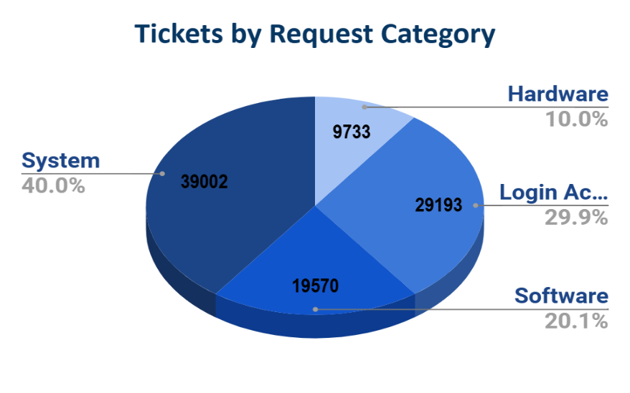
the distribution of ticket categories
Observation: System and Login Access are the most frequent categories, suggesting common pain points in those areas.

Slide 7
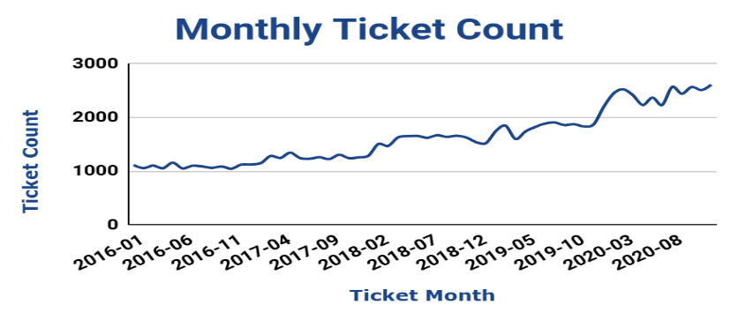
average daily ticket volume over time
Observation: Ticket volume grew steadily over the first quarter, suggesting increased system usage or reliability issues.

Slide 8
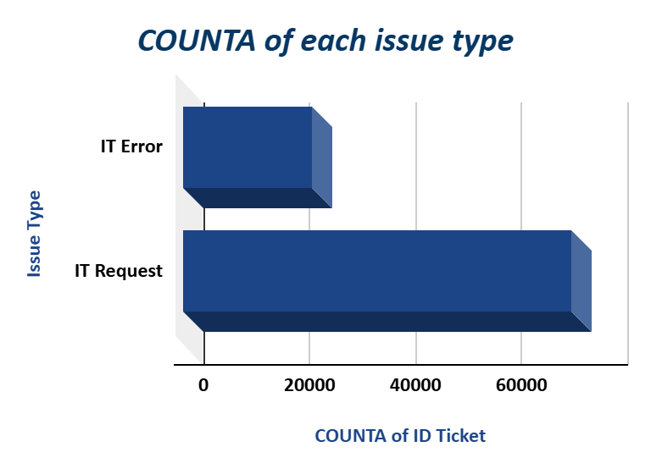
count of each issue type
Observation: IT Requests outnumber IT Errors by 3:1, indicating a primarily service-oriented IT support desk.

Slide 9
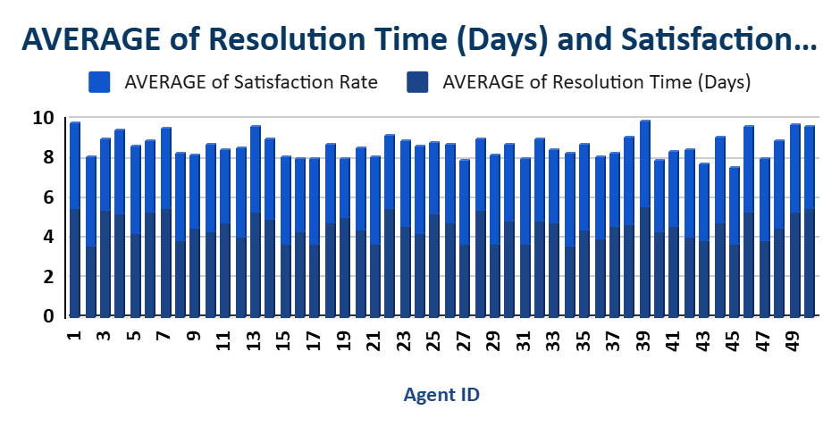
performance metrics
Performance Outliers: Agent 39 have high average resolution times (>5.5 hours) and agent 19 have low satisfaction ratings (<3.0).
Recommendations: Focus areas: Time management, technical troubleshooting, customer communication.

Slide 10
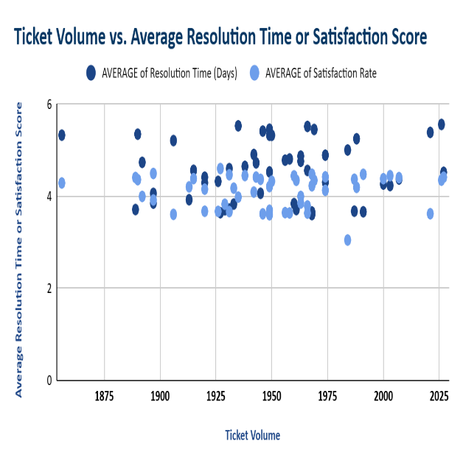
IT agents training programs
A small subset of agents handles a disproportionately high number of tickets, yet still maintain high satisfaction and fast resolution.
Several agents with lower ticket volume underperform in both resolution time and satisfaction—indicating uneven workload distribution.
Rebalance workload before hiring: redistribute tickets more evenly to assess whether existing capacity can meet demand.

Slide 11
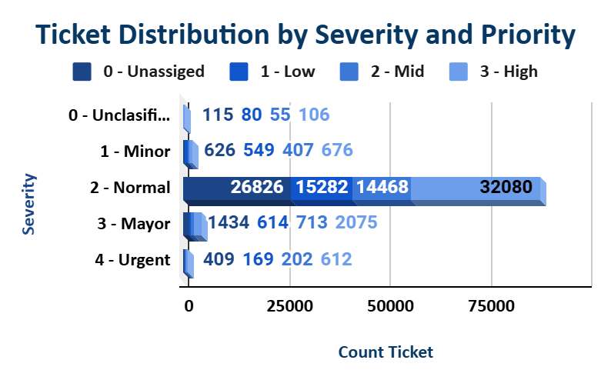
Ticket distribution by severity and priority
Over 26,000 Severity 2 (Normal) tickets have Unassigned priority, and many have low or mid priority.
Misaligned combinations (e.g. Normal–Low Priority) lead to longer resolution times.
Well-aligned pairs (e.g. Urgent–High Priority) are resolved the quickest.

Slide 12
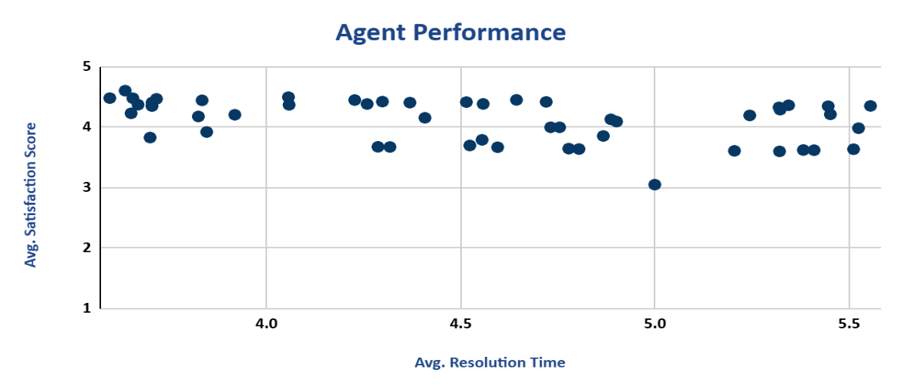
Agent performance
Most agents maintain satisfaction scores above 4.
Resolution times mostly fall between 3.5 to 5.5 hours.
There are no agents achieving satisfaction scores below 3.0, except one outlier at 5.0 hours with ~3.0 score.
For Underperforming Agents: For those with resolution times >5.2 hrs, provide coaching on time management and ticket prioritization.

Slide 13
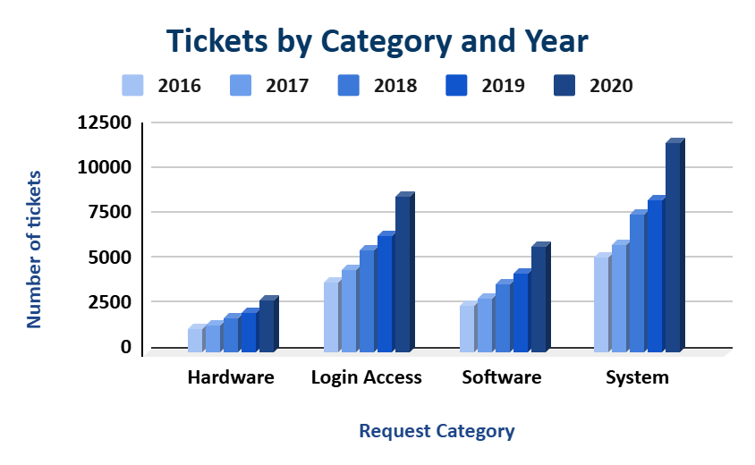
performance of the IT support team
Overall ticket volume increased every year across all categories.
System category shows the highest growth, surpassing 10,000 tickets in 2020.
Login Access is consistently the second highest and shows steady growth.
System & Login Access: These two categories need more resources (dedicated teams, automation) to manage rising demand.

Slide 14
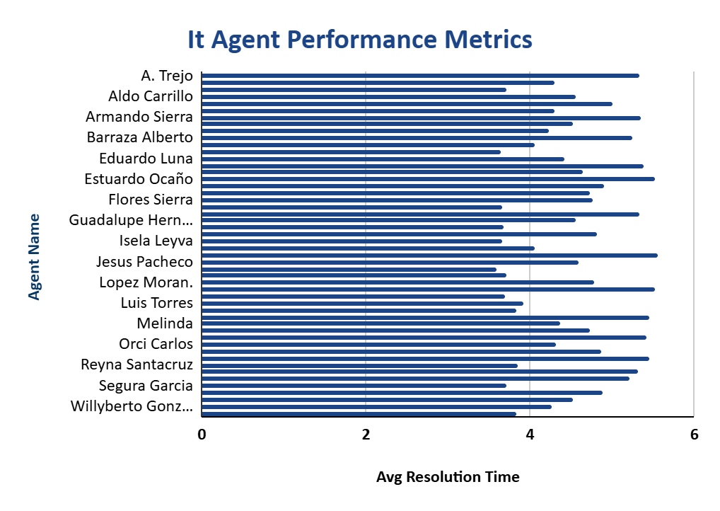
key performance metrics for IT agents
Ticket Volume Is Similar Across Agents: Most agents have resolved around 2000 tickets, indicating balanced workload distribution.
Resolution Time Varies Slightly: While differences are subtle, some agents show higher average resolution times, suggesting delays or more complex issues.
Encourage Knowledge Sharing: Have top-performing agents mentor others. Agents with high satisfaction and low-resolution times can help improve overall team performance.

Slide 15
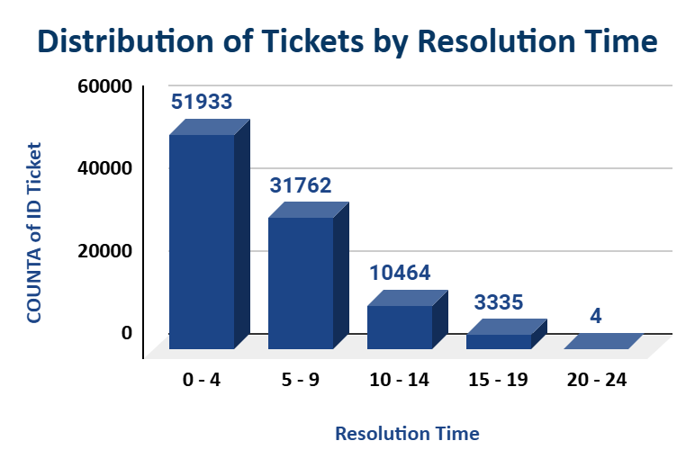
Resolution Time Performance Analysis of IT Support Tickets
Most IT tickets are resolved quickly, with half closed within 4 days, showing strong operational efficiency.
Ticket resolution is highly efficient early on, but a sharp decline after day 9 suggests a need to address long-resolution cases.

Slide 16
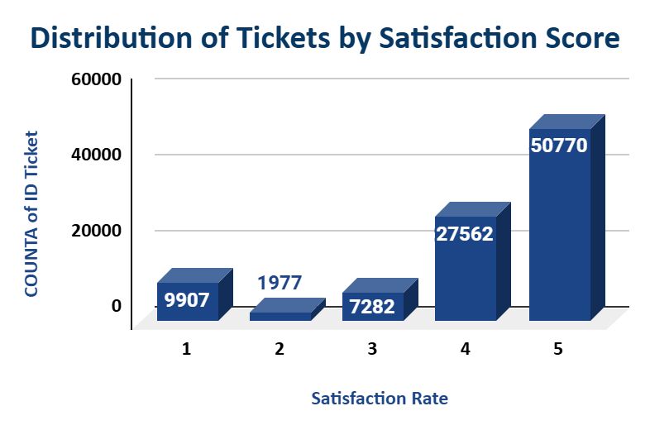
Analysis of Ticket Satisfaction Scores in IT Support
A majority of users (over 60%) rated their support experience with the highest satisfaction score (5), indicating strong overall service performance. However, nearly 20% of tickets received low satisfaction scores (1–3), pointing to opportunities for service improvement.
Investigate low satisfaction scores (1–3) to identify recurring issues such as delays, communication gaps, or unresolved problems.

Slide 17
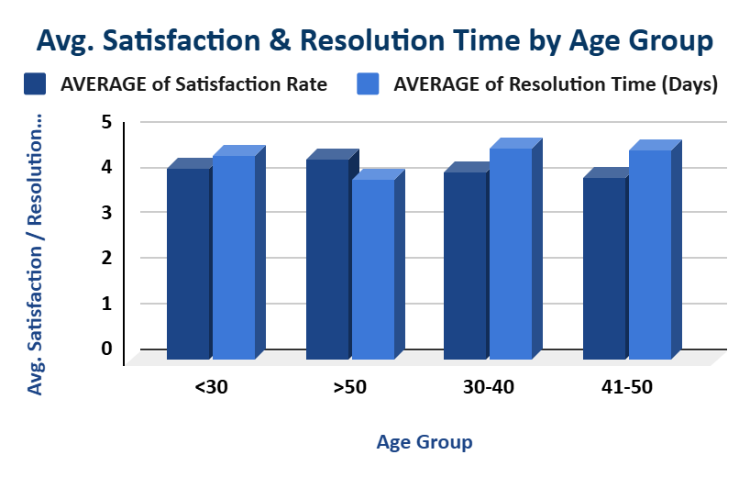
Comparison of Satisfaction and Resolution Time Across Age Groups
Employees over 50 reported the highest satisfaction with the lowest resolution time.
Age groups 30–50 had longer resolution times and lower satisfaction, especially ages 41–50, indicating potential service gaps.
Improve response strategies for employees aged 30–50 to reduce resolution times and enhance satisfaction.

Slide 18
Strategic Recommendations
18
Based on our analysis of IT support ticket data, we propose the following actions:
Prioritize High-Severity Ticket Routing | Balance Agent Workloads | Develop Targeted Training Programs | Introduce Predictive Monitoring of Ticket Trends
Tickets marked as “High” severity experience longer resolution times. | Analysis shows a small group of agents handles a disproportionate number of tickets. | Some agents consistently receive lower satisfaction scores, especially on complex issue types. | Trend analysis reveals spikes in specific issue types during end-of-quarter periods.
Routing these to experienced agents first can reduce resolution delays. | Implement automated workload distribution to prevent burnout and performance dips. | Use performance metrics to identify training needs by category (e.g., network vs. software). | Use this pattern to proactively staff and prepare for known surge times.
Expected Impact: Faster incident response, higher SLA compliance. | Expected Impact: Improved resolution times and agent satisfaction. | Expected Impact: Higher first-contact resolution rates, better customer experience. | Expected Impact: Reduced backlog, smoother operations during peak demand.

Slide 19
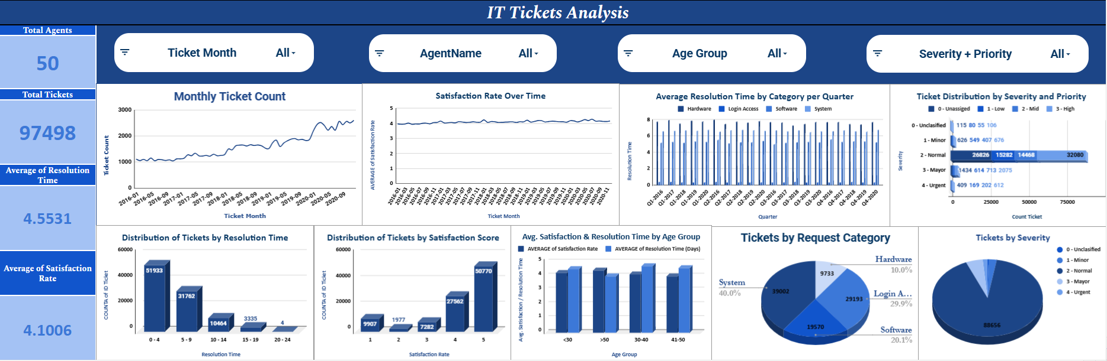
Dashboard and Visualizations

Slide 20
Conclusion
The IT support team shows strong operational performance, with most tickets resolved within 4 days and over 60% of users giving a satisfaction rating of 5.However, performance inconsistencies exist among agents-some face challenges with resolution time or satisfaction, especially on complex issues. Ticket volume is increasing year-on-year, particularly for System and Login Access categories, signaling a need for improved support scalability. Certain agent demographics (especially those aged 41–50) correlate with lower satisfaction and longer resolution times, hinting at targeted support gaps. A significant number of tickets (Severity 2) are mis-prioritized, leading to slower resolutions.

Slide 21
Recommendations
Balance Agent Workloads Redistribute tickets more evenly before expanding the team. Use automation for ticket assignment to reduce agent burnout.
Implement Targeted Training Focus on agents with <3.5 satisfaction or >5.2 hour resolution time. Prioritize training in time management, customer handling, and issue diagnosis. Introduce Predictive Monitoring Use trend analysis to forecast high-demand periods (e.g., quarter-end spikes) and allocate resources proactively. Prioritize High-Severity Routing Develop an automated triage system to route high-severity tickets directly to experienced agents for faster resolution. Improve Support for Age 30–50 Employees Tailor communication and support protocols for mid-age employees who report lower satisfaction and face longer resolution times. Leverage High Performers Enable peer mentoring by having top-performing agents guide others, especially those with low ticket volumes and weak KPIs.

Slide 22
Acknowledgements & References
Contributions:
Isha Sarkar – Data Analysis & Visualization, Data Cleaning & Preparation, Dashboard Development & Insights Review
Special thanks to \[Mentor/Supervisor] for their guidance and feedback throughout the project.
References & Data Sources:
Internal IT Support Ticket Logs (2016–2020)
Agent Demographics – HR Records
IT Service Management Best Practices – ITIL v4 Framework
Excel & Google Sheets functions (VLOOKUP, PivotTables, Conditional Formatting)

